Slide 1
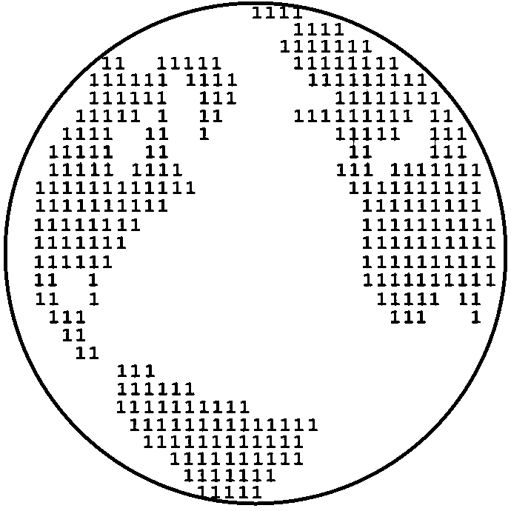
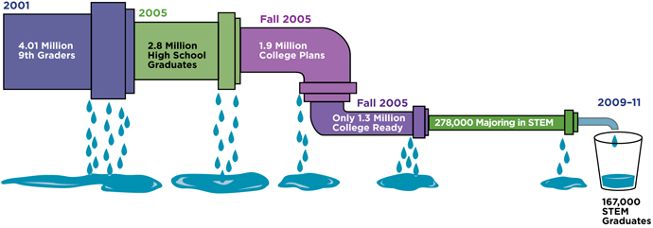
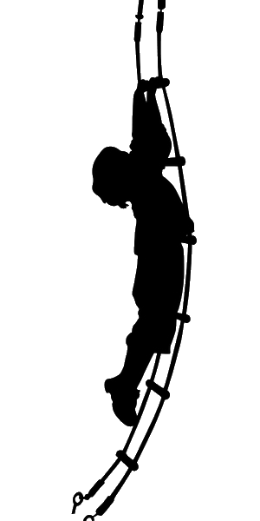

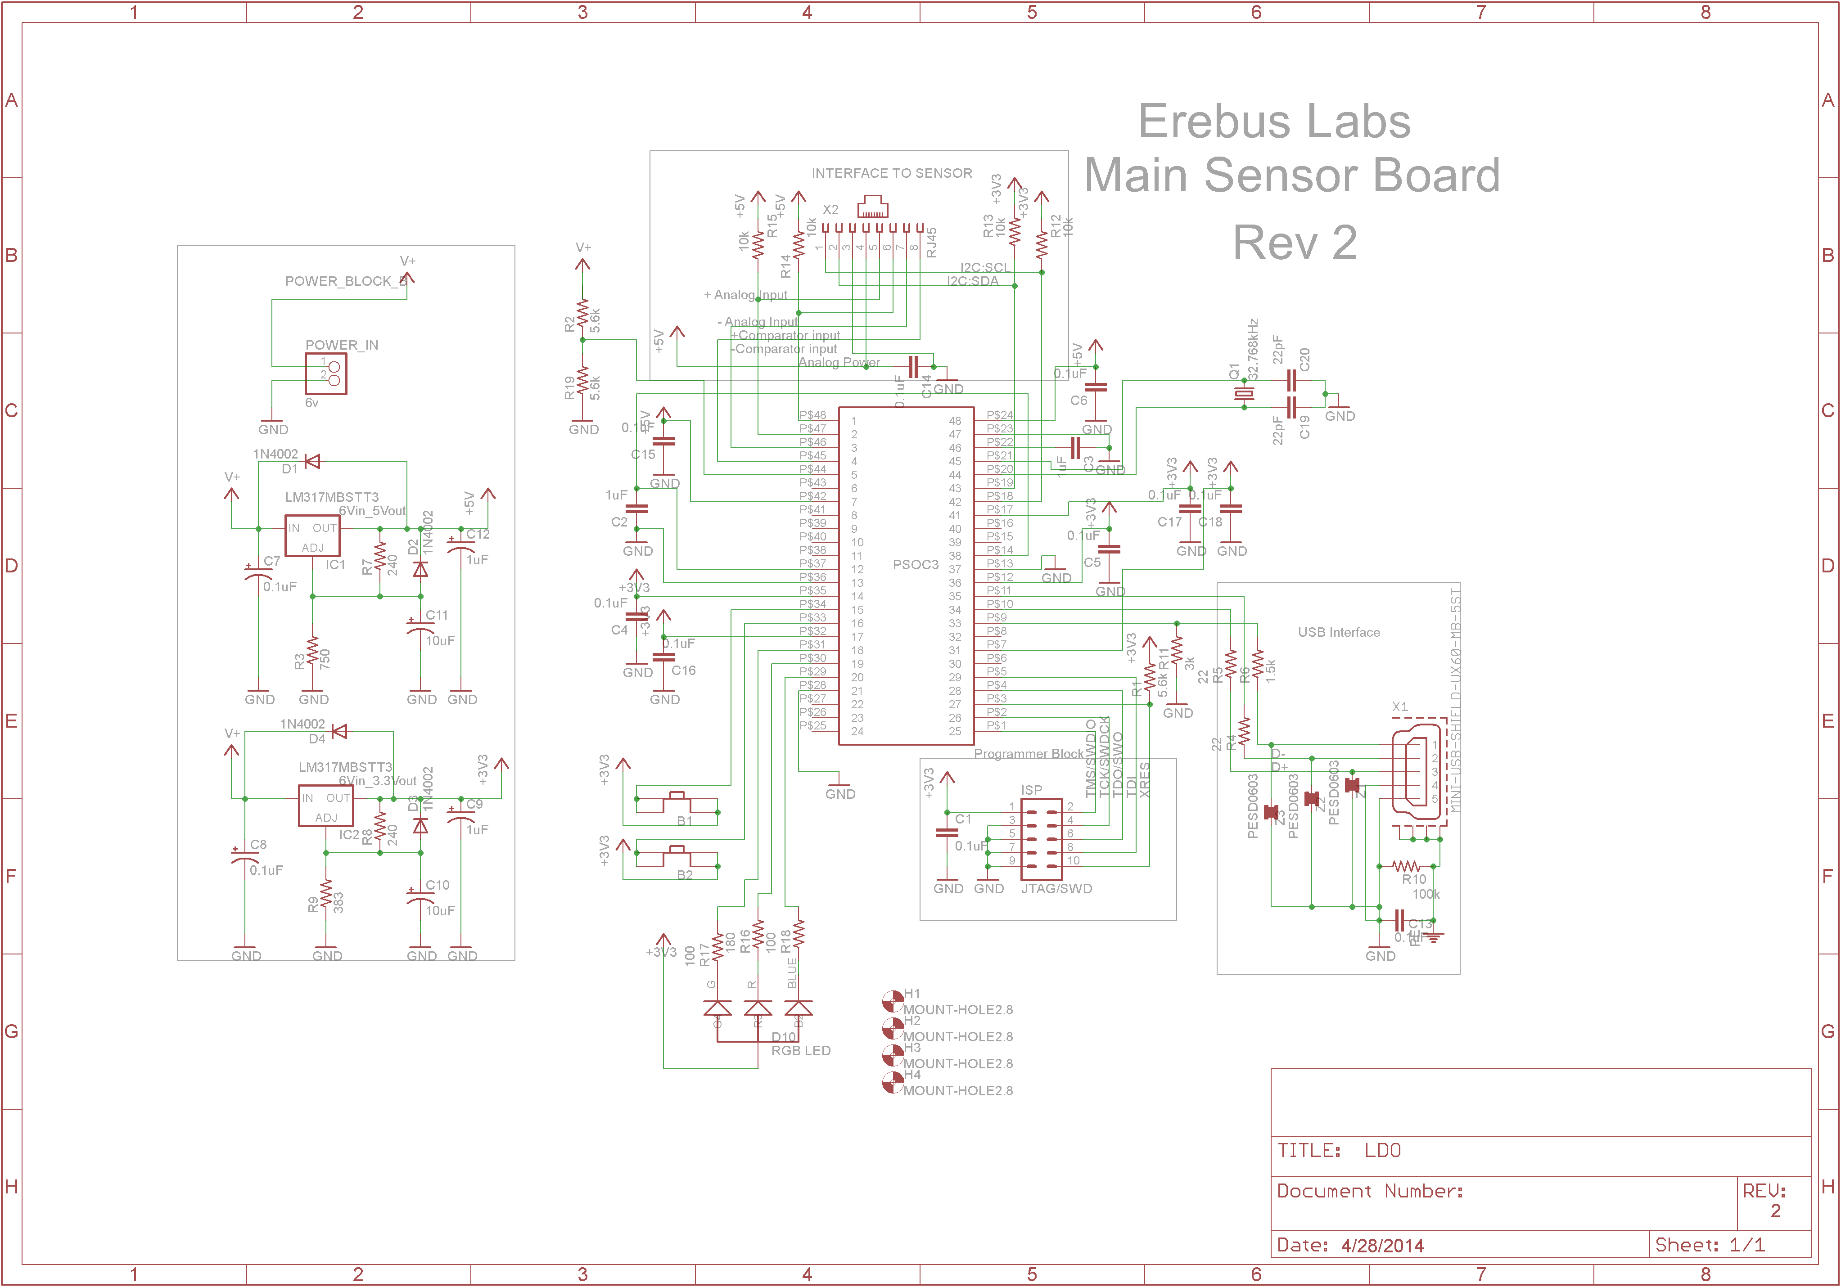
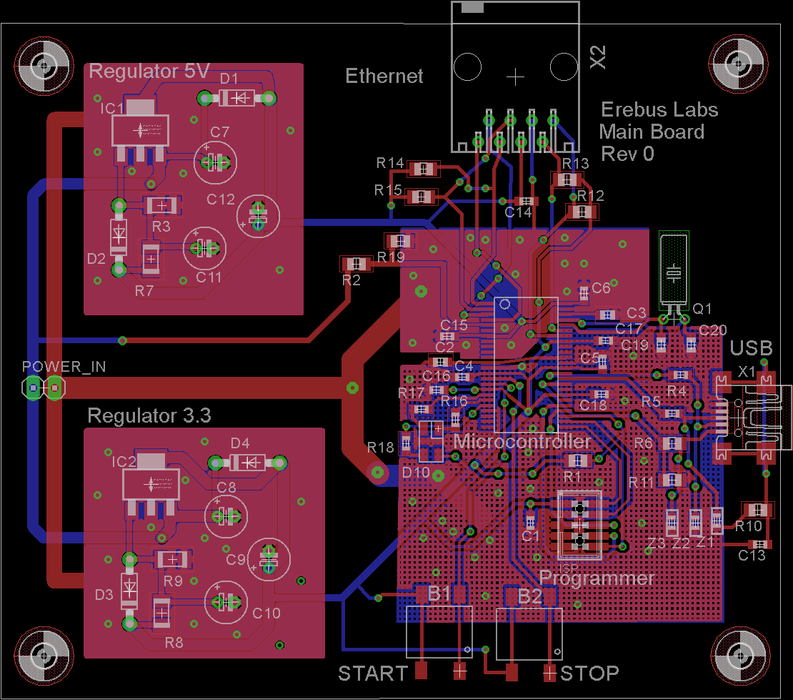



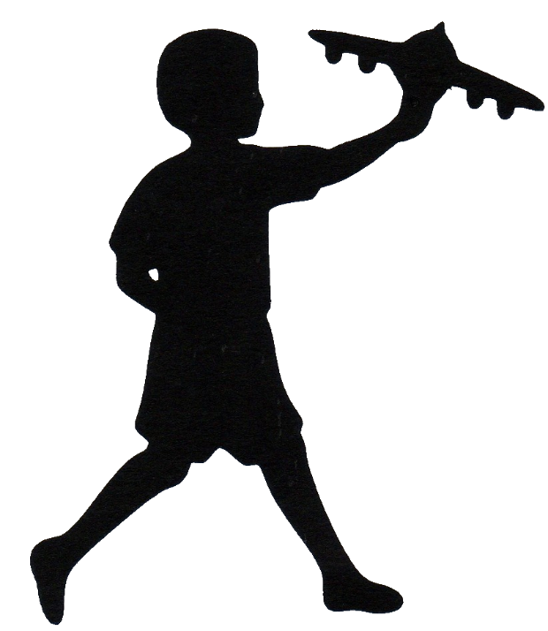

Erebus Labs STEM Sensor
Overview
Implementation
Current educational curriculum in the US lacks a focus on Science, Technology, Engineering, and Mathematics (commonly referred to as STEM). Though more emphasis is starting to be placed on STEM education, a major hurdle for that education is simply getting kids interested in STEM topics. Negative interest begins in elementary classrooms where %33 of fourth grade students’ attitudes are already hostile towards science and math with that number increasing to %50 by 8th grade¹. Furthermore, according to the United States department of education, only %16 of American high school seniors are proficient in mathematics and interested in a STEM career².
Our goal was to create a device that would allow students, or anyone who is interested, to easily measure the world around them. Getting kids interested in the idea of science and engineering is the first step to
Surveys performed by the National Center for Education Statistics (NCES) in 2013 showed that 42% of 4th grade students performed at or above proficiency in mathematics which is fundamental to all STEM fields. By 8th grade that proficiency dropped to 36%. It is both this decrease in proficiency the large decrease in interest in STEM which we want to address by making STEM subjects more interesting to younger student.
50% of 8th graders have a hostile attitude towards math & science
The Team
Scott Lawson
Computer Engineering
Maxwell Cope
Electrical Engineering
Bryan Button
Electrical Engineering
Chris Clary
Electrical Engineering
References
Mike Borowczak, Ph.D. - Sponsor
Data Analytics Engineer @ SolidFire
Founder @ ErebusLabs
www.becpdx.org/nem/stemconnect.aspx
www.ed.gov/stem
http://nationsreportcard.gov/reading_math_2013
Andrea Burrows - Sponsor
Assistant Professor of Secondary Education
University of Wyoming
James E. Morris - Advisor
Professor of Electrical and Computer Engineering
Portland State University
Department of Electrical and Computer Engineering

